Slide 1

How to Have a Successful Reddit Thread

Slide 2
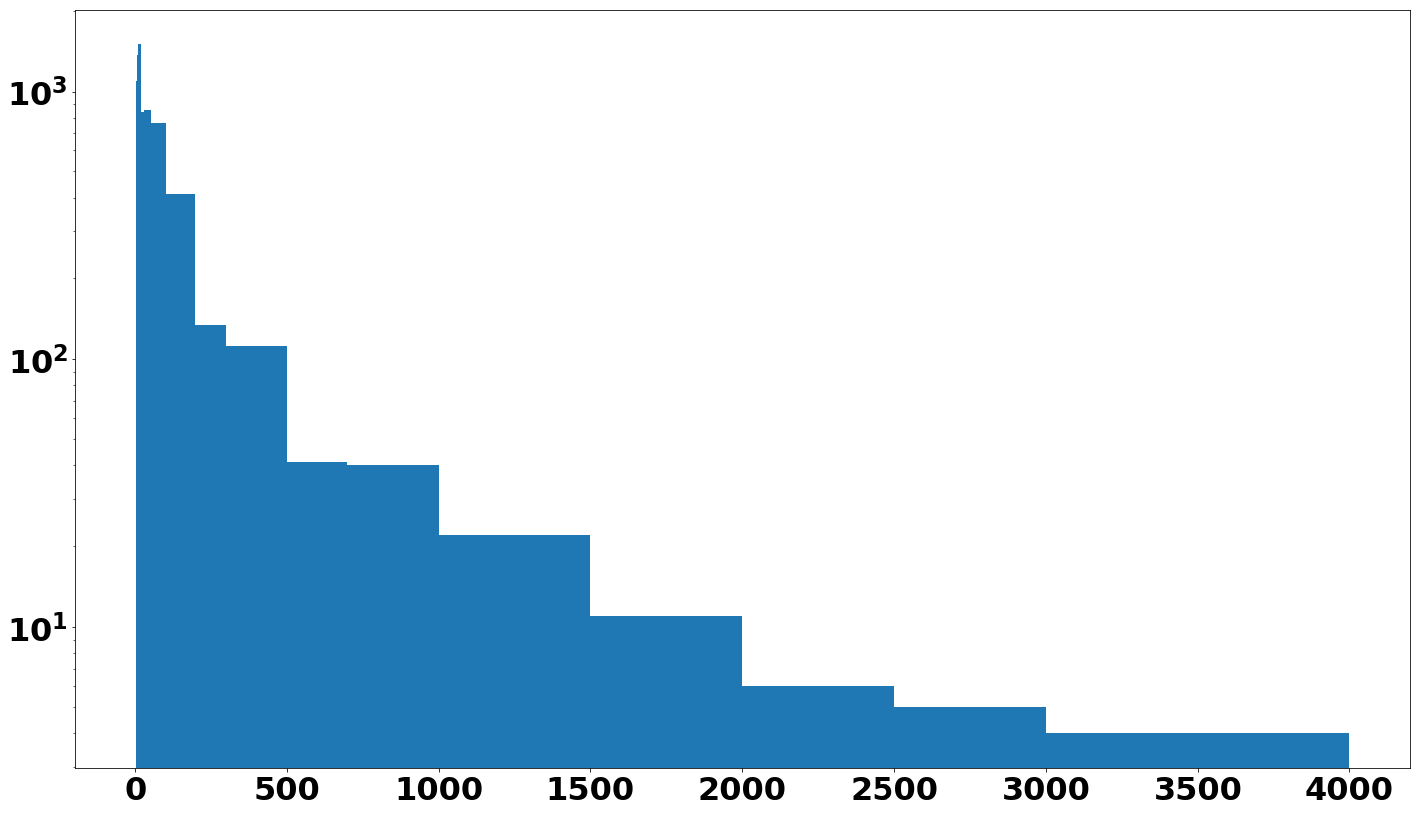
Success = Number of Comments
Threads: 7775
Median number
of comments: 14
Notes:
There are many ways we might measure a successful reddit thread, but for our purposes here we’re measuring by number of comments (relative to the median).
Threads collected over a fifteen-hour period on May 24 from reddit.com/hot.

Slide 3
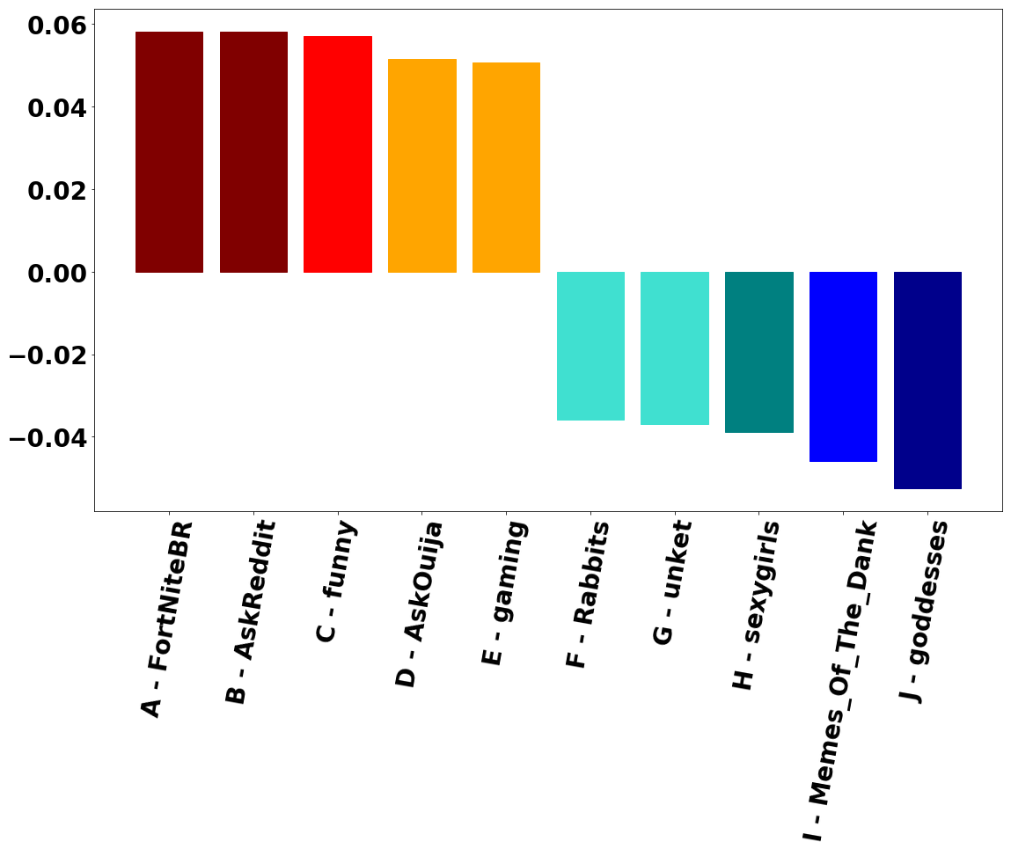
Subreddit correlation with success
was low.

Slide 4
Success Words
GAME MAKE YEARS 2018
GOING RIGHT TRUMP
DOES WORK LIFE NEED
Notes:
I vectorized the title words, sorted the posts by success / failure, and then by prevalence of words. There was some overlap (i.e. certain words are popular regardless of success / failure, but then I checked to see which words were in the top 30 for successful but not in the top 30 for unsuccessful posts and vice versa.
In Top 30 Success, not in Top 30 Failure

Slide 5
Failure Words
POST LITTLE REAL OLD
FINALLY GIRL IRL
LOOKING CAT DOG WAY
Notes:
In Top 30 Failure, not in Top 30 Success

Slide 6
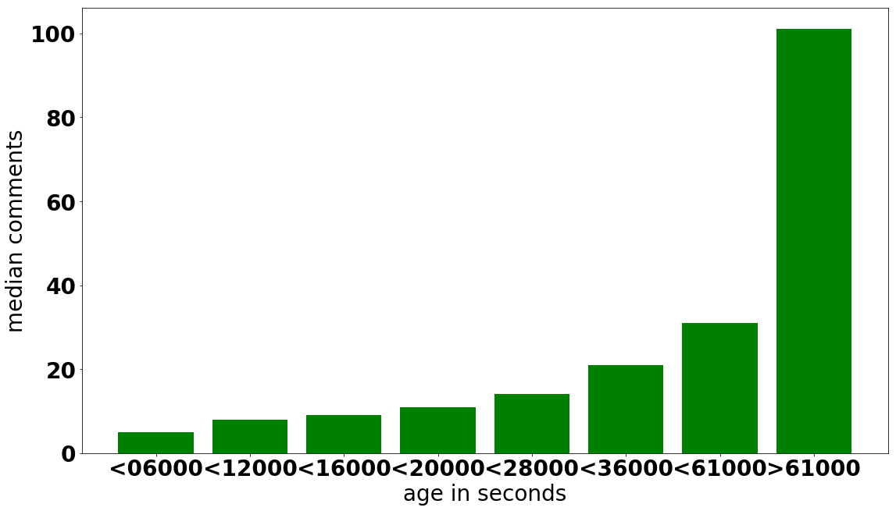
Give it the Night!
Notes:
Unsurprisingly, age is correlated with success. The longer a post is up, the longer it has to gain comments.

Slide 7
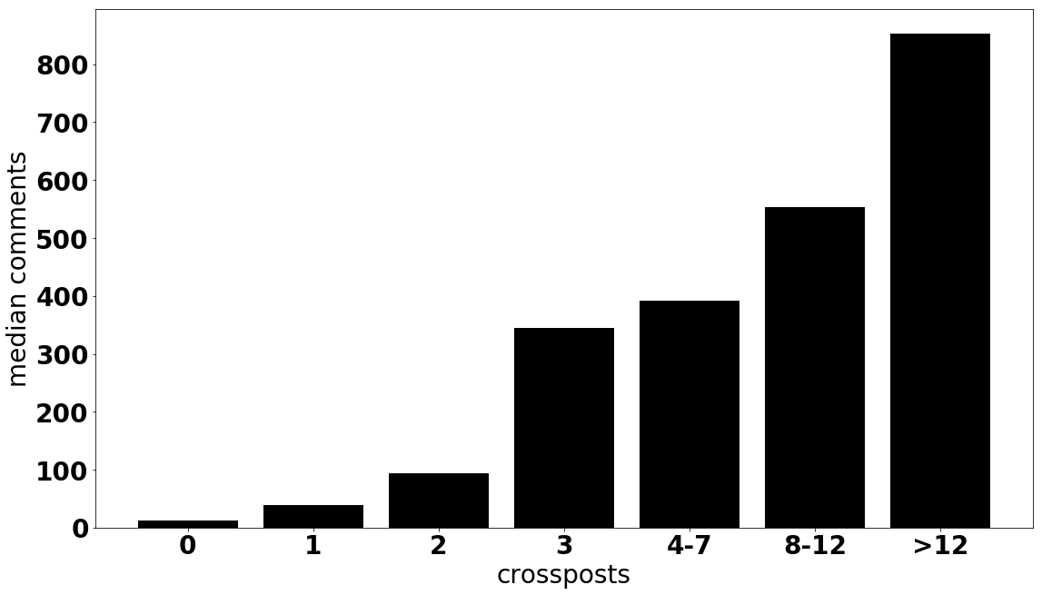
Consider Crossposting
Notes:
The vast majority of posts are catalogued by only one subreddit. But those with multiple listings are much more successful.

Slide 8
Non-Voluntary Factors Correlated with Success
Whitelist - All Ads
Subreddit Subscribers
(successful subreddits only)
Score
(upvotes less downvotes)

Slide 9
My Tree Model is (Conservatively) 71% Accurate
It takes into account:
Whether the parent’s whitelist is set to ‘all ads’
Thread’s score
Number of crossposts
Identity of subreddit
Number of subreddit subscribers
How long the thread has been up
Notes:
X = pd.concat([allreds[['pwlsAllAds', 'score', 'num_crossposts', 'subreddit_subscribers', 'Age',
'title']], subdums], axis = 1)

Slide 10
What’s Next?
Get more data
Subreddit factor still largely irrelevant?
Same words’ correlation with success / failure?
Re-run the model
Same success?
I was able to construct a Random Forest model with 99.9% sensitivity.
Notes:
RF Model: 99.9% sensitivity, i.e. very few false negatives, i.e. cases of successful posts predicted to be unsuccessful.

